Slide 1

When solving the AlarmClockRadio problem, should your solution have one class or many?
One class
Many classes

Slide 2

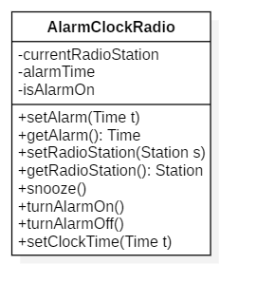
Having a single class leads to many problems.
What happens if:
the clock class changes?
the alarm clock changes?
the radio changes?
any of the components aren’t needed?
Return to previous decision

Slide 3

Good answer, a quality solution definitely has more than one class to improve maintainability.
Given that you have multiple classes, how should those classes be related?
Using only inheritance
Using only aggregation
Using a combination of inheritance and aggregation

Slide 4
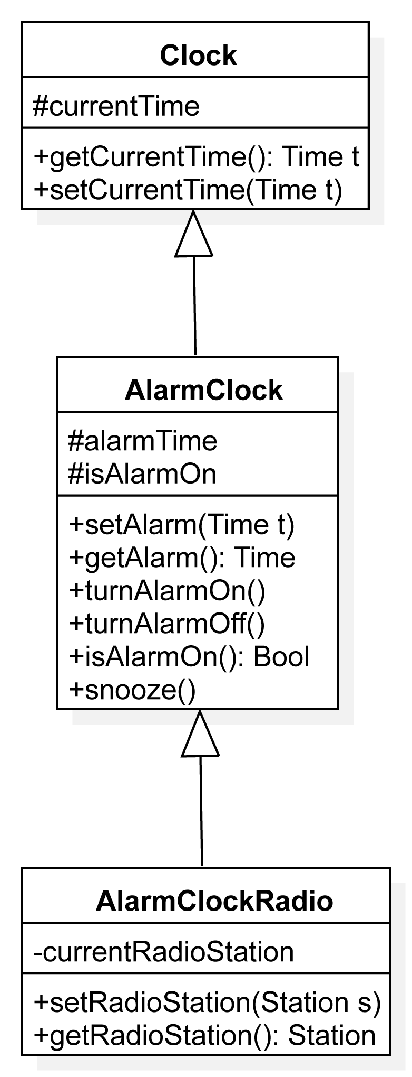
If you use only inheritance you might have a solution similar to one of the following:
Is this solution ideal?
This solution is ideal
Using only inheritance was not the correct design direction, return to previous decision.
Note, one could start with Radio, derive ClockRadio and then derive AlarmClockRadio in a similar fashion, but it would still be wrong.

Slide 5
Choosing only inheritance is a poor choice.
Having only inheritance creates a problem if you want to create only a radio object with the solution on the left and a problem if you want just a clock / alarm clock with the solution on the right.
A more nuanced approach is needed.
Return to previous decision

Slide 6
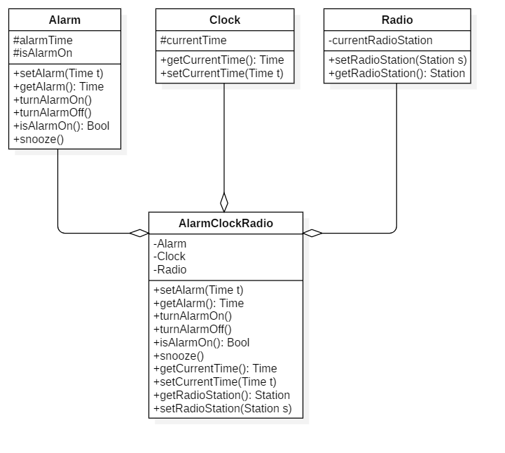
Choosing only aggregation is a poor choice.
Having only aggregation provides modularity and the ability to instantiate only an alarm, clock or radio, but it doesn’t provide any real reuse.
Return to previous decision

Slide 7
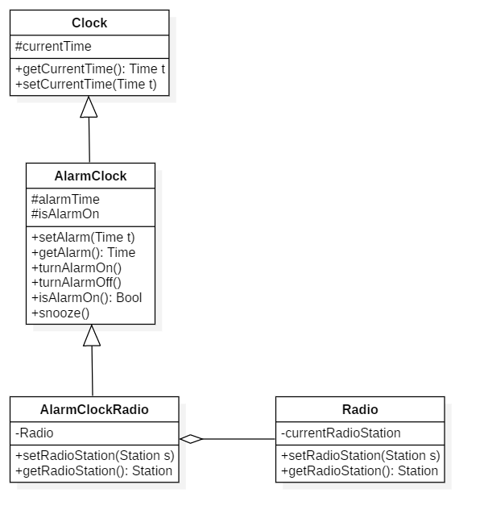
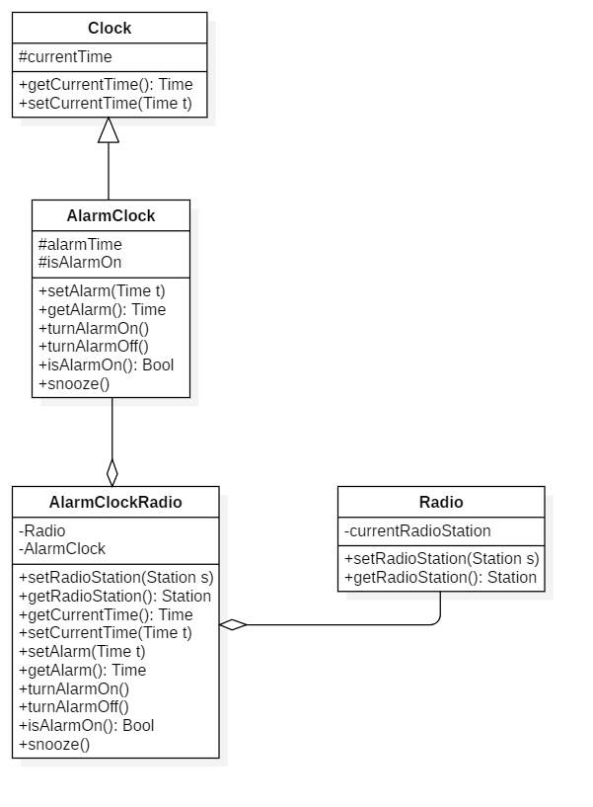
Choosing both aggregation and inheritance is ideal, however, there are many ways to choose from. Click on the design that is the best:

Slide 8

This is a good solution, but does the alarm clock radio have to inherit from AlarmClock or could it just be aggregated?
The current solution is fine
Aggregation of the AlarmClock is prefered

Slide 9

By using inheritance here, there is a challenge if your AlarmClockRadio needs a different clock or alarm clock. Aggregation was the better choice.
View the aggregation of AlarmClock solution

Slide 10
This is the ideal solution. It allows reuse of both alarm clock and radio while also allowing AlarmClock to reuse the base functionality of Clock.

